Slide 1

FHIR® North 2018

Slide 2
House Keeping
Washrooms
WIFI = Guest
#FHIRNorth
Survey
CPHIMS-CA

Slide 3
Agenda
 | FHIR Academy |  | Code Camp - Introduction | Code Camp - Introduction | Code Camp - Advanced
TIME
9:00-9:15 | Welcome & Opening Remarks
9:15-9:30 | Transition to Code Camp or FHIR Academy
9:30-10:15 | FHIR for Executives |  |  | FHIR for Beginners & Code Camp Orientation | SMART on FHIR Introduction
10:15-10:30 | Coffee Break - Common Area
10:30-11:30 | Panel Session: What are European Countries doing with FHIR? | Moderator: Attila Farkas Netherlands: Alexander Henket – HL7 Lead at Nictiz Norway: Oyvind Aassve - Senior Advisor at The Norwegian Directorate of eHealth Germany: Stefan Lang – Technical FHIR Committee member at HL7 Germany England: Richard Kavanagh - NHS API Labs - Programme Head |  | Hacking Time - Guided Exercises | Infoway to Lead an Exercise
11:30-12:00 | Panel Session: What are Ontario and Other Canadian Jurisdictions doing with FHIR? | Yaron Derman |  |  | Testing Tools
12:00-1:00 | Lunch - Common Area

Slide 4
Agenda
 | FHIR Academy |  | Code Camp - Introduction | Code Camp - Advanced
1:00-1:45 | Office of the National Coordinator: What is the US doing with FHIR? | Steven Posnack: Video Conference | CDS Hooks
1:45-2:15 | Infoway's Implementers Support Overview of tools to support the complete SDLC | Attila Farkas | eReferral | Intro to the innovation lab and test instances of DHIR, DHDR, and other EHR assets
2:15-2:45 | Clincians on FHIR | David Hay
2:45-3:00 | Coffee Break - Common Area
3:00-3:30 | SMART on FHIR API: Cerner's Lesson Learned | Kevin Sheckelton | Intro to Profiling | eHealth Ontario led exercises on making connections to EHR assets
3:30-3:45 | Abstract Submission: FHIR for Big Data | François Decourcelle
3:45-4:00 | Abstract Submission: eReferral | Tim Berezny
4:00-4:15 | Abstract Submission: Our use of FHIR in an Ecosystem of Modern Healthcare | TBD
4:15-4:30 | Transition to Code Camp Demonstrations
4:30-5:00 | Demonstrations | Moderator: Gavin Tong & James Agnew

Slide 5
Triple Aim of Healthcare
Improving the patient experience of care (including quality and satisfaction);
Improving the health of populations; and
Reducing the per capita cost of health care.
Patient Care
Reduce Costs
Population Health
http://www.ihi.org/engage/initiatives/tripleaim/Pages/default.aspx

Slide 6
What To Expect
Informal
Collaborative
Hands on

Slide 7
Organizing Committee
James Agnew (Smile CDR)
Paul Brown (Mohawk College)
Attila Farkas (Canada Health Infoway)
Agrima Kashyap (Gevity)
Lloyd McKenzie (Gevity)
Natalie Shearer (Mohawk College)
Gavin Tong (Gevity)

Slide 8
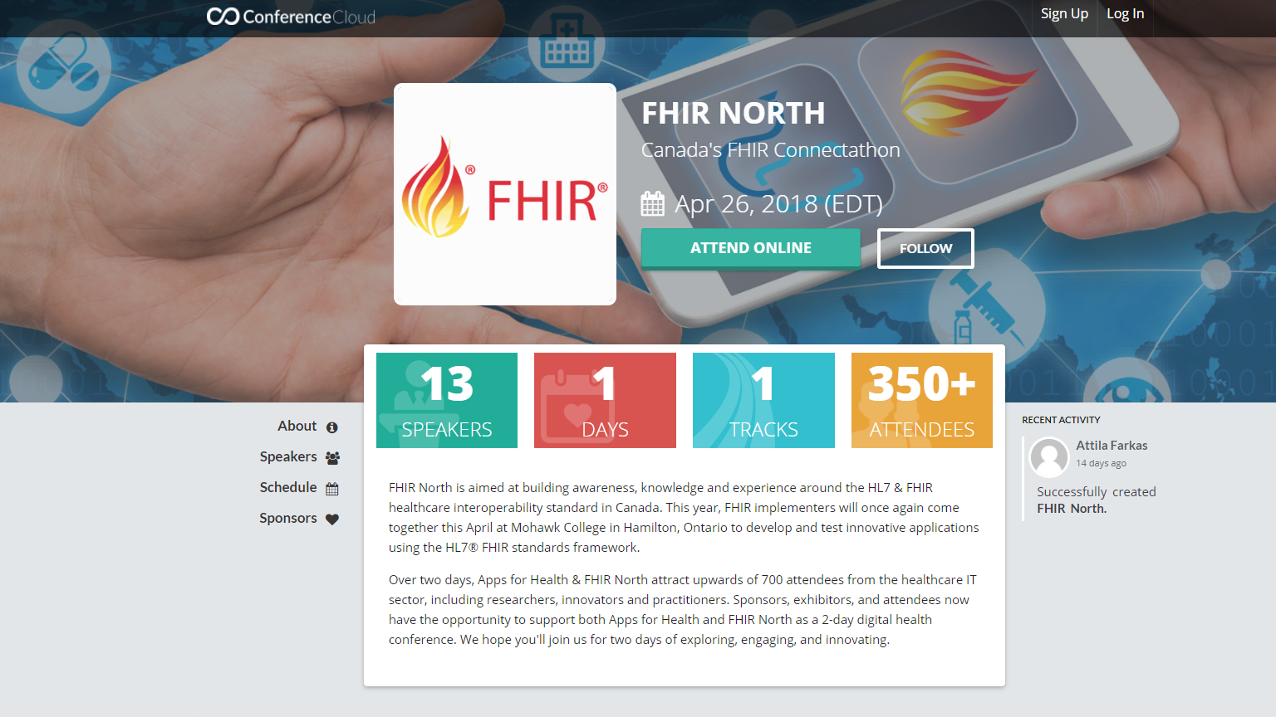
Video Cast
www.conferencecloud.co/e/fhir-north

Slide 9
BIG THANKS
Agrima Kashyap and Natalie Shearer
Sponsors
Speakers
Mohawk

